Slide 1
TEXT SUMMARIZER
Project Authors -
Amey Thakur & Mega Satish
Notes:
Hello all, I am Amey Thakur. Allow me to introduce you with my work. We worked on Natural Language Processing (NLP) project which is Text Summarizer. I collaborated with Miss Mega and together we created this simple yet elegant project.
Topic is straightforward and easy to understand before digging deep into it I would like to walk you through the abstract.

Slide 2
ABSTRACT
Text summarization is the process of making a synopsis from a given text document while keeping the important information and meaning of it.
Automatic summarization has become an essential method for accurately locating significant information in vast amounts of text in a short amount of time and with minimal effort.
In this project, we propose to implement a web application that can summarize a text or a Wikipedia link. We have additionally been given an opportunity to compare different methods of summarization.
Notes:
When you open news sites, do you just start reading every news article? Probably not. We typically glance the short news summary and then read more details if interested. Short, informative summaries of the news is now everywhere like magazines, news aggregator apps, research sites, etc.
Well, It is possible to create the summaries automatically as the news comes in from various sources around the world.
The method of extracting these summaries from the original huge text without losing vital information is called as Text Summarization. It is essential for the summary to be a fluent, continuous and depict the significant.
In fact, the google news, the inshorts app and various other news aggregator apps take advantage of text summarization algorithms

Slide 3
INTRODUCTION
Text summarization is one of the Natural Language Processing (NLP) applications that will undoubtedly have a significant influence on our lives.
With the rise of digital media and ever-increasing publication, who has the time to read complete news items, documents, books to determine whether they are beneficial or not?
Automatic Text Summarization is among the most complex and intriguing topics in Natural Language Processing (NLP).
It is the way of forming a brief and coherent summary of writing from a variety of text sources, including books, news stories, blog posts, research papers, emails, and tweets.
The advent of vast volumes of textual data is driving up demand for automatic summarization technologies.
Notes:
Propelled by the modern technological innovations, data is to this century what oil was to the previous one. Today, our world is parachuted by the gathering and dissemination of huge amounts of data.
In fact, the International Data Corporation (IDC) projects that the total amount of digital data circulating annually around the world would sprout from 4.4 zettabytes in 2013 to hit 180 zettabytes in 2025. That’s a lot of data!
With such a big amount of data circulating in the digital space, there is need to develop machine learning algorithms that can automatically shorten longer texts and deliver accurate summaries that can fluently pass the intended messages.
Furthermore, applying text summarization reduces reading time, accelerates the process of researching for information, and increases the amount of information that can fit in an area.

Slide 4
PROBLEM STATEMENT
The tremendous abundance of material available on the internet has produced an odd paradox: people are immersed in information, yet they are yearning for wisdom.
It is tough to keep up with the internet's daily production of billions of articles. Is there a method to absorb information more effectively in this case without increasing reading time?
We are proposing for the above problem a Text Summarizer web app using NLP and NLTK libraries.
Notes:
Usually, text summarization in NLP is treated as a supervised machine learning problem (where future outcomes are predicted based on provided data).

Slide 5
PRESENT SOLUTIONS
Inshorts
Inshorts is a news app that selects latest and best news from multiple national and international sources and summarises them to present in a short and crisp 60 words or less format, personalized in both, English or Hindi.
Summarizer Bot
AI and blockchain-powered tool which allows users to know more by reading less with summarization of long texts. It includes Wikipedia articles, white papers, web pages, and even audio and images.
Resoomer This tool generates accurate summaries of texts, allowing you to filter through documents by key topics, identify important facts and ideas, and interpret articles faster.
Notes:
These are few solutions which industries use currently to process their data and deliver it to the end consumer.
I am sure some of you have heard about these solutions as these are used widely by many individuals around the globe.

Slide 6
METHODS
Gensim is an open source library in python used in unsupervised topic modelling and natural language processing. It is designed to extract semantic topics from documents. Summarizing is based on ranks of text sentences using a variation of the TextRank algorithm.
NLTK is an essential library supports tasks such as classification, stemming, tagging, parsing, semantic reasoning, and tokenization in Python. It’s basically your main tool for natural language processing and machine learning.
spaCy is a free, open-source library for advanced Natural Language Processing (NLP) in Python. It is designed specifically for production use. It can be used to build information extraction or natural language understanding systems, or to pre-process text for deep learning.
Sumy is an open-sourced Python library to extract summaries from HTML pages and text files. The package also contains an evaluation framework for text summaries. Sumy offers several algorithms and methods for text summarization such as LexRank and TextRank.
Notes:
We focused on these 4 methods in this project.

Slide 7
INDUSTRY USE CASES
Media Monitoring The issue of overload of information and content shock can be solved by automatic summarization as presents it can condense the continuous torrent of information into smaller pieces of information.
Search Marketing and SEO
Multi-document summarization can be a powerful tool to quickly analyze dozens of search results, understand shared themes and skim the most important points.
Internal Document Workflow
Summarization can enable analysts to quickly understand everything the company has already done in a given subject, and quickly assemble reports that incorporate different points of view.
Medical Cases
Summarization can be a crucial component in the tele-health supply chain when it comes to analyzing medical cases and routing these to the appropriate health professional.
Books and Literature
Summarization can help consumers quickly understand what a book is about as part of their buying process.
Notes:
Here are some of the current use cases of the text summarization.

Slide 8
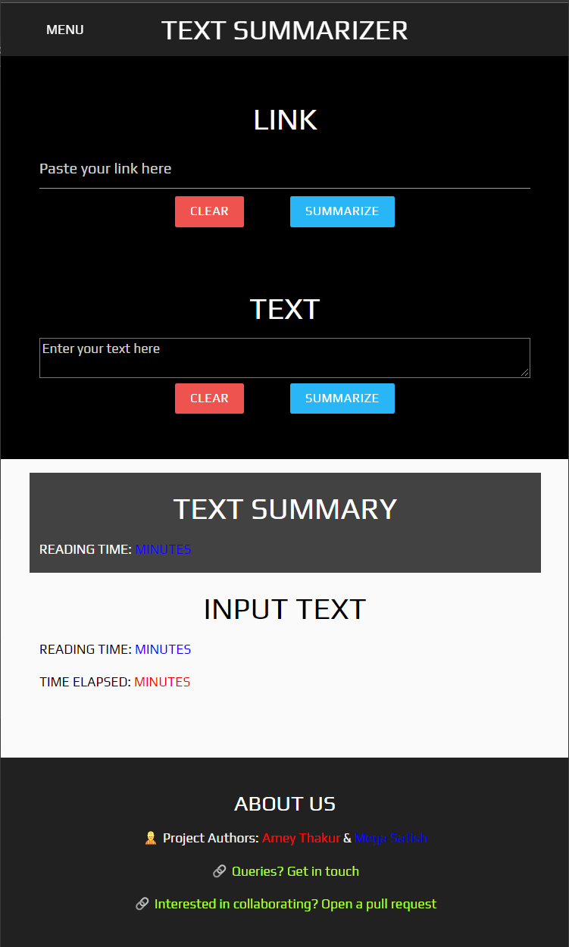
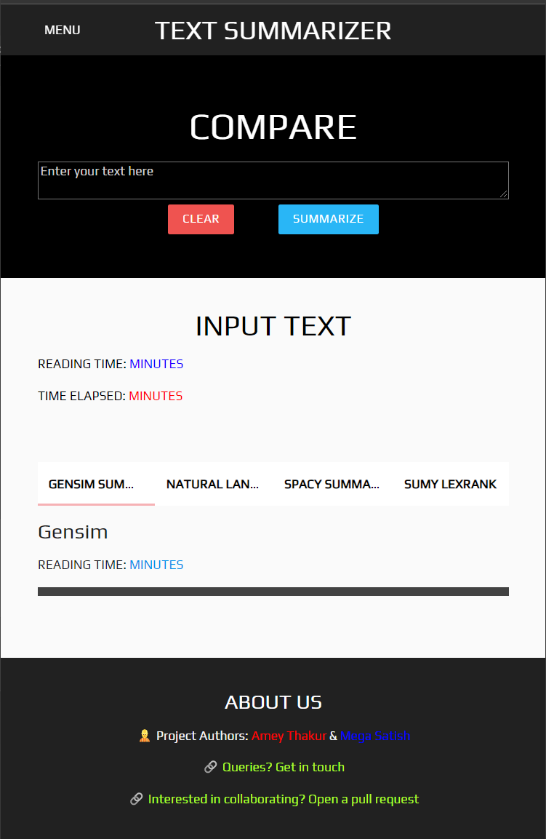
RESULTS
Web Application: http://textssummarizer.herokuapp.com
Notes:
This is our UI. As you can see, we have provided two sections here: one for the link and the second for the text.
We get the summary in the below section where we can see our Reading Time and the time elapsed.
We have also provided a page to compare the output of different packages available.

Slide 9
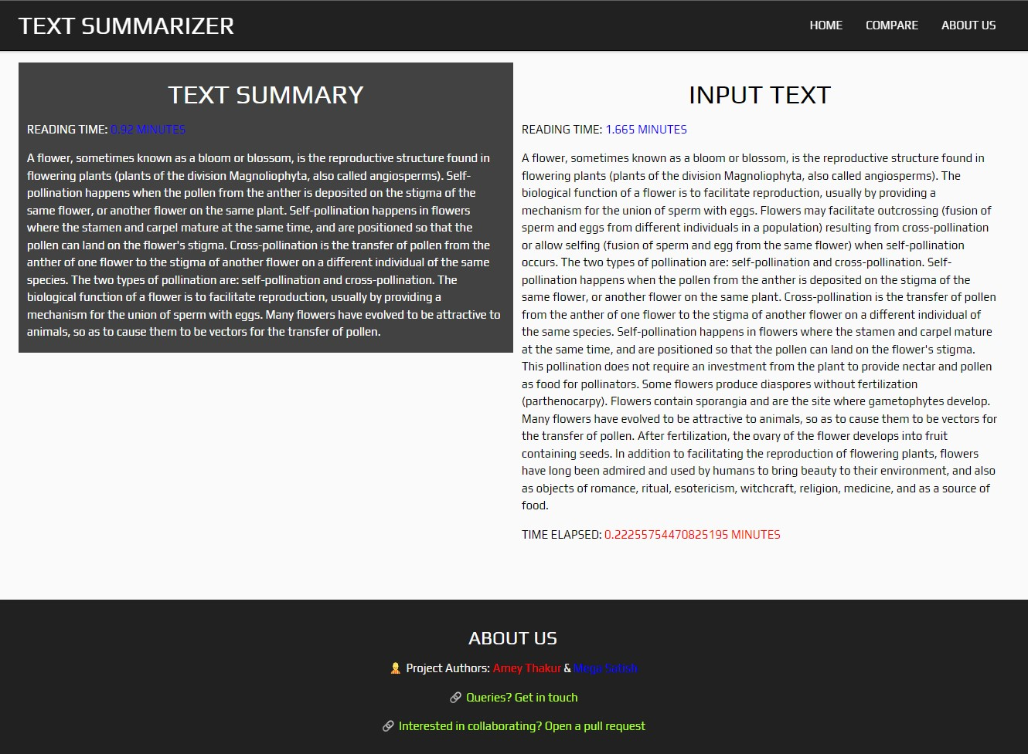

Slide 10
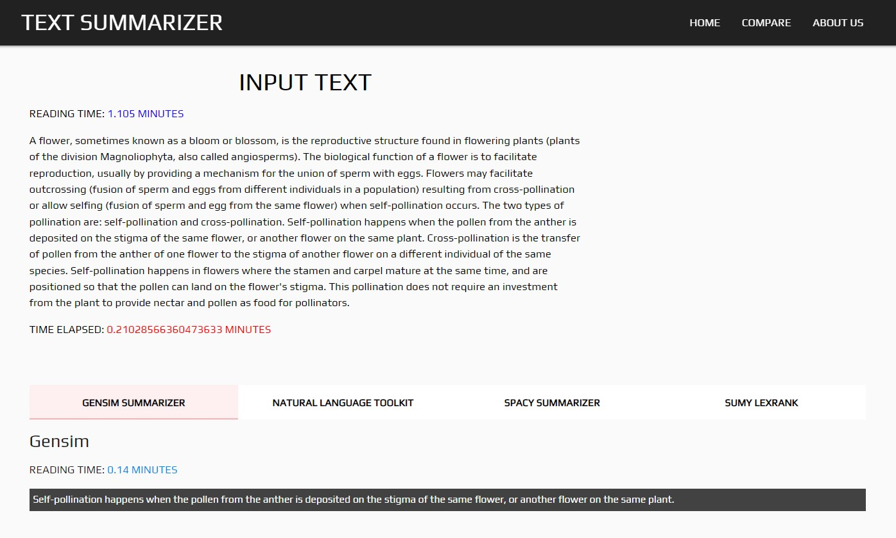
Notes:
gensim is a very handy python library for performing NLP tasks. The text summarization process using gensim library is based on TextRank Algorithm
What is TextRank algorithm?
TextRank is an extractive summarization technique. It is based on the concept that words which occur more frequently are significant. Hence , the sentences containing highly frequent words are important.
Based on this , the algorithm assigns scores to each sentence in the text . The top-ranked sentences make it to the summary.

Slide 11
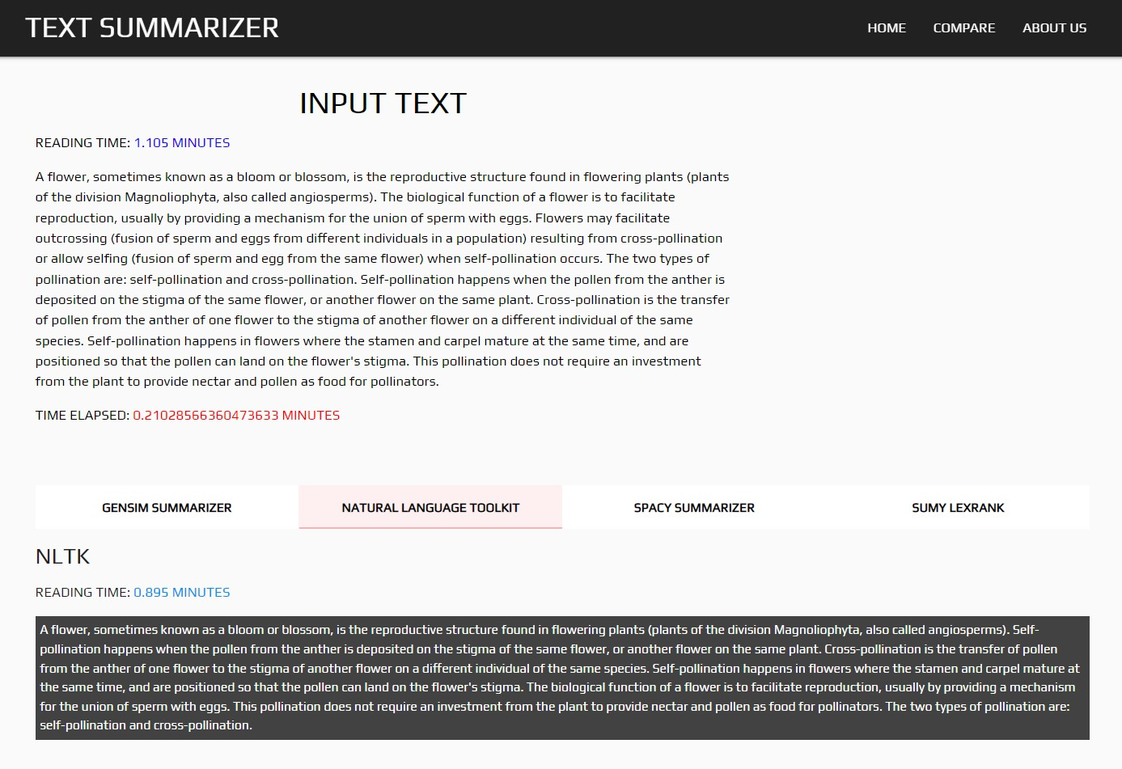
Notes:
Stopwords is used to remove the stop words which are not necessary for the comprehension of text.
Here, punkt library is also applied and used to tokenize the sentences.
Punkt tokenizer divides a text into a list of sentences, by using an unsupervised algorithm to build a model for abbreviation words, collocations, and words that start sentences.

Slide 12
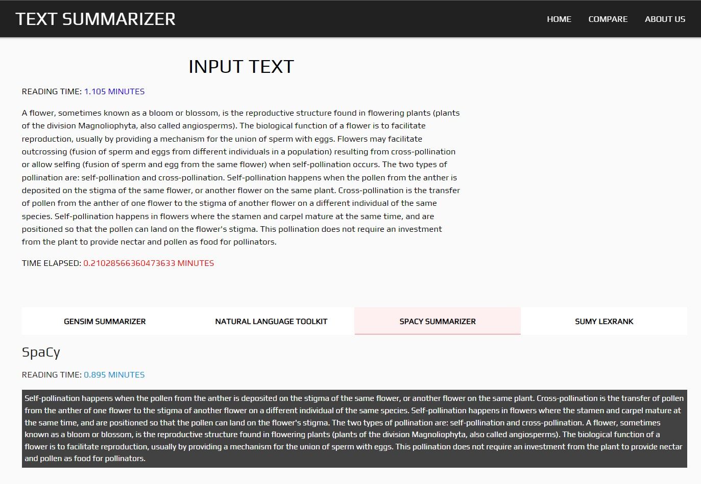
Notes:
Trained Pipelines are available in the spaCy modules. Here we have used a pre build and trained pipeline “en_core_web_sm”.
It is an english pipeline optimized for CPU.
It’s components: tok2vec, tagger, parser, senter, ner, attribute_ruler, lemmatizer.
The pipeline can be used for production use as it can be easily integrated in the workflow and build process.

Slide 13
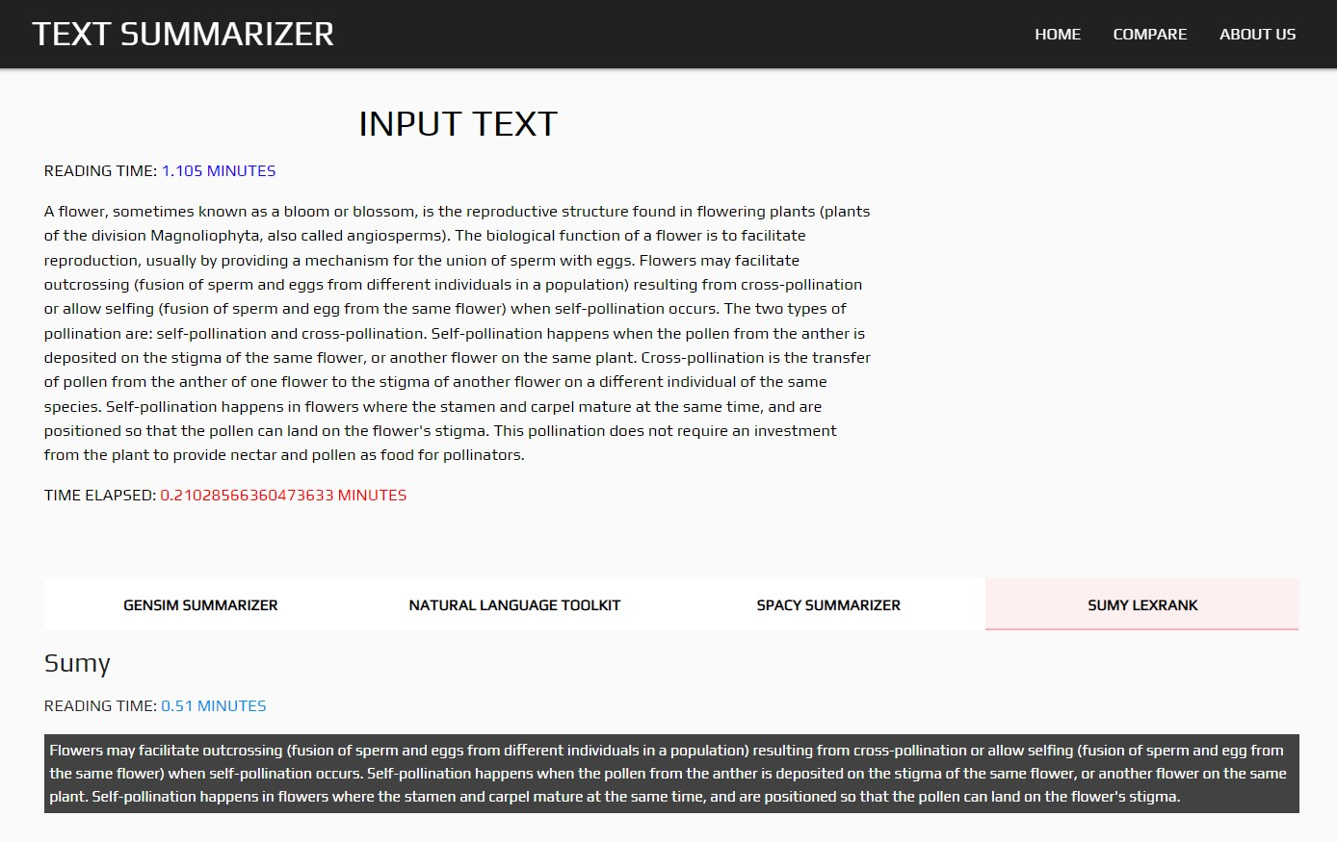
Notes:
A sentence which is similar to many other sentences of the text has a high probability of being important. The approach of LexRank is that a particular sentence is recommended by other similar sentences and hence is ranked higher.
Higher the rank, higher is the priority of being included in the summarized text.

Slide 14
THANK YOU
Project Title - Text Summarizer
Project Authors - Amey Thakur & Mega Satish

